Slide 1




Spring Framework
Spring Framework
The most popular opensource Java Framework

Slide 2



Java EE Concept - Java Enterprise Edition
What is a Java Web Application?
A Java web application generates interactive web pages containing various types of markup language (HTML, XML, and so on) and dynamic content. It is typically comprised of web components such as JavaServer Pages (JSP), servlets and JavaBeans to modify and temporarily store data, interact with databases and web services, and render content in response to client requests.

Slide 3







Java EE Concept - Java Enterprise Edition
What is a Java EE?
Java EE is a platform-independent, Java-centric environment for developing, building and deploying Web-based enterprise applications online. Java EE includes components of the Java Standard Edition (Java SE).The Java EE platform consists of a set of services, APIs, and protocols that provide the functionality for developing multitiered, Web-based applications.

Slide 4

Java EE Concept - JSP (JavaServer Page)
What is a JSP?
JavaServer Pages (JSP) is a technology for developing web pages that support dynamic content which helps developers insert java
code in HTML pages by making use of special JSP tags.
JSP have access to the entire family of Java APIs, including the
JDBC API to access enterprise databases.

Slide 5























Java EE Concept - Severlet
What is Servlet?
Java Servlets are programs that run on a Web or Application server and act as a middle layer between a request coming from a Web browser or other HTTP client and databases or applications
on the HTTP server.
Using Servlets, you can collect input from users through web
page forms, present records from a database or another source,
and createwebpages dynamically.

Slide 6
Java EE Concept - Web MVC (JSP & Servlet)
Model :
The Model component corresponds to all the data-related logic that the user works with. This can represent either the data that is being transferred between the View and
Controller components or any other business logic-related data.
Views:
The View component is used for all the UI logic of the application.
Controllers:
Controllers act as an interface between Model and View components to process all the business logic and incoming requests, manipulate data using the Model component and
interact with the Views to render the final output.

Slide 7
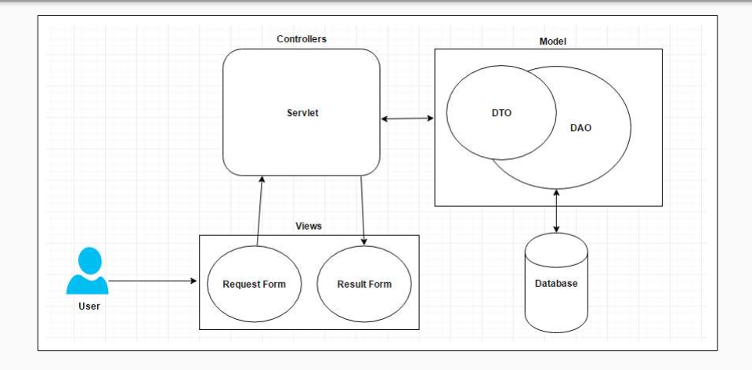
Java EE Concept - Web MVC (JSP & Servlet)

Slide 8


What is a Framework?
Frameworks are large prewritten code to which you add your own code to solve a problem in a specific domain.
You make use of a framework by calling its methods, inheritance and supplying “call-backs” listeners.
Example - Java’s Swing and AWT classes. Those have a huge amount of code to manage the user interface and there is inversion of control.

Slide 9
1. Introduction - Spring Overview
What is Spring Framework?
It is a lightweight and open source java framework created byRod Johnson in 2003.The core features of the Spring Framework can be used in developing any Java.
Spring is the most popular application development framework for enterprise Java. Millions of developers around the world use Spring Framework to create high performing, easily testable, reusable code.
It can be thought of as a framework of frameworks because it provides support to various frameworks such as Struts, Hibernate, MyBatis, EJB etc.
The Spring framework comprises several modules such as IOC, AOP, DAO, Context, ORM, WEB MVC etc.
The Spring Framework is an application framework and inversion of control container for the Java platform. The framework's core features can be used by any Java application, but there are extensions for building web applications on top of the Java EE (Enterprise Edition) platform. Although the framework does not impose any specific programming model, it has become popular in the Java community as an addition to the Enterprise JavaBeans (EJB) model. The Spring Framework is open source.

Slide 10
1.
Introduction - Spring Overview
What is the benefits of using Spring Framework?
★ Open-source Framework ★ Non-invasive
★ Extendible for other frameworks ★ Reusable code
★ Testability
Why do we use Spring Framework?
Spring makes programming Java quicker, easier, and safer for everybody. Spring's focus on speed, simplicity, and productivity has made it the world's most popular Java framework.
Is Spring MVC and Spring Framework?
Spring MVC is a part of the Spring framework that helps in handling HTTP requests and responses. On the other hand, Spring Boot is the extension of the Spring framework and provides a faster way to build applications

Slide 11
Features Of Spring Framework
Spring is a Framework of Frameworks
• Lightweight
• Layered Architecture
• Predefined Templates
• Fast Development
• MVC Framework
• Inversion Of Control (IOC)
• Aspect Oriented Programming (AOP)
• Data Access Framework
• JDBC Abstraction Layer
• Logging

Slide 12


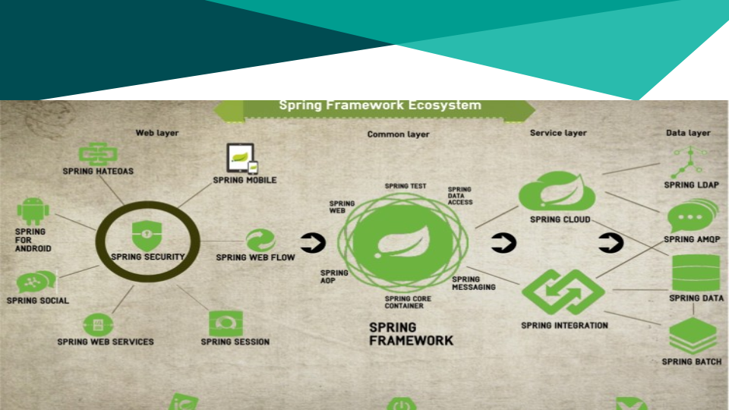
Spring Framework Ecosystem

Slide 13
History
The first version was written by Rod Johnson, who released the framework with the publication of his book Expert One-on-One J2EE Design and Development in October 2002. The framework was first released under the Apache 2.0 license in June 2003. The first production release, 1.0, was released in March 2004.
The Spring 1.2.6 framework won a Jolt productivity award and a JAX Innovation Award in 2006.
Spring 2.0 was released in October 2006, Spring 2.5 in November 2007, Spring 3.0 in December 2009, Spring 3.1 in December 2011, and Spring 3.2.5 in November 2013. Spring Framework 4.0 was released in December 2013.Notable improvements in Spring 4.0 included support for Java SE (Standard Edition) 8, Groovy 2, some aspects of Java EE 7, and WebSocket.
Spring Boot 1.0 was released in April 2014.
Spring Framework 4.2.0 was released on 31 July 2015 and was immediately upgraded to version 4.2.1, which was released on 01 Sept 2015.[8] It is "compatible with Java 6, 7 and 8, with a focus on core refinements and modern web capabilities".
Spring Framework 4.3 has been released on 10 June 2016 and will be supported until 2020. It will be the final generation within the general Spring 4 system requirements (Java 6+, Servlet 2.5+).
Spring 5 is announced to be built upon Reactive Streams compatible Reactor Core.

Slide 14
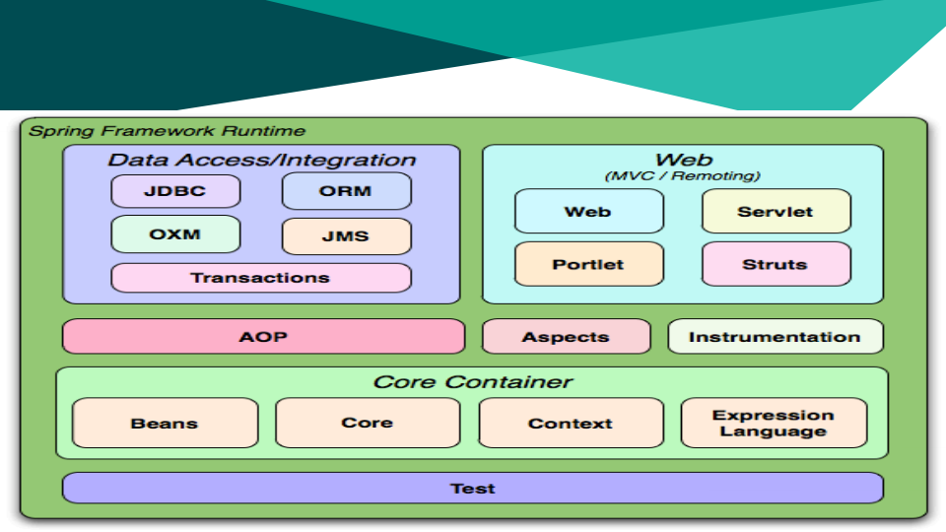
Overview Spring Framework Architecture

Slide 15
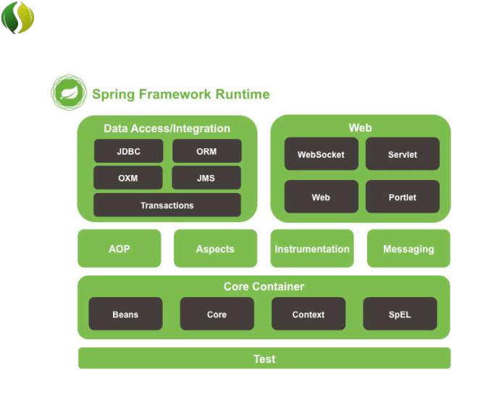
Spring Modules
• The Spring Framework consists of features organized into about 20 modules.
• These modules are grouped into Core Container, Data Access/Integration, Web, AOP (Aspect Oriented Programming), Instrumentation, and Test.
Overview of the Spring Framework
18

Slide 16
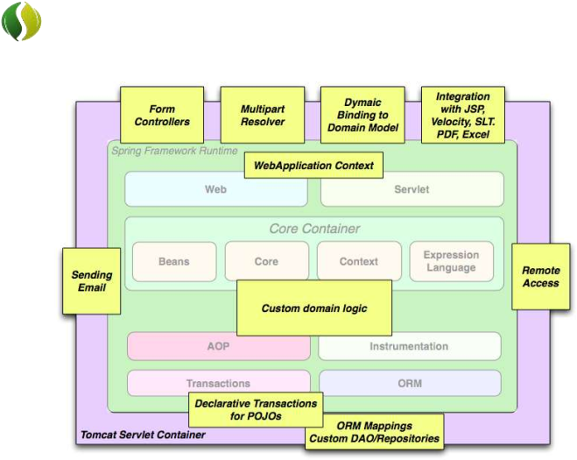
Spring Modules
• The building blocks described previously make Spring a logical choice in many scenarios, from applets to full- fledged enterprise applications that use Spring's transaction management functionality and web framework integration.
Typical full-fledged Spring web application
19

Slide 17

Spring Modules
Spring Projects
• Spring XD
• Spring Data
• Spring Integration
• Spring Batch
• Spring Security
• Spring Cloud
• Spring AMQP
• Spring Grails
• Spring Mobile
• Spring Social
• Spring for Android
• Spring Web Flow
• Spring LDAP
• Spring Groovy
• Spring Hateoas
• Spring Security OAuth
20

Slide 18

Advantages of Using Spring Framework
• Open source
• Lightweight and fast
• Moduler structure
• Low coupling thanks to Dependency Injection
• Resuable software
• AOP support
• Stable and lots of resources
• Projects that make our life easier like Spring Security
21

Slide 19
Spring Framework Architecture
The Spring framework is a layered architecture which consists of several modules.
All modules are built on the top of its core container.
It's modular architecture enables integration with other frameworks without much difficulties.
Consists of around 20 modules which are generalized into Core Container, Data Access/ Integration, Web, AOP (Aspect Oriented Programming), Instrumentation, and Test. All the modules have their own functionalities that are utilized to build an application.

Slide 20
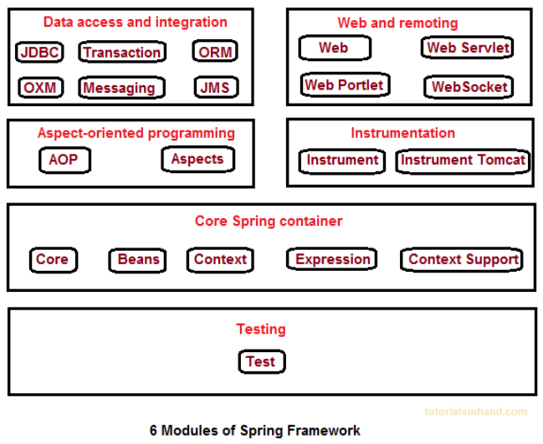
Spring Framework Modules

Slide 21
Spring Framework Modules
Core Container
1. Spring Core: This module is the core of the Spring Framework. It provides implementation for features like IoC (Inversion of Control) and Dependency Injection with singleton design pattern.
2. Spring Bean: This module provides implementation for the factory design pattern through BeanFactory.
3. Spring Context: This module is built on the solid base provided by the Core and the Beans modules and is a medium to access any object defined and configured.
4. Spring Expression Languages (SpEL): This module is an extension to expression language supported by Java server pages. It provides a powerful expression language for querying and manipulating an object graph, at runtime.

Slide 22
Spring Framework Modules
AOP Module
• Spring AOP module provides interceptors to intercept an application, for example, when a method is executed, you can add extra functionality before or after the method execution.
• Spring AOP's approach to AOP differs from that of most other AOP frameworks. The aim is to provide a close integration between AOP implementation and Spring IoC, not to provide the most complete AOP implementation.

Slide 23
Spring Framework Modules
Spring Data Access/ Integration
i. | JDBC: This module provides JDBC abstraction layer which eliminates the need of repetitive and unnecessary exception handling overhead. ORM: ORM stands for Object Relational Mapping. This module provides
ii.
consistency/portability to our code regardless of data access technologies based on object oriented mapping concept.
iii. OXM: OXM stands for Object XML Mappers. It is used to convert the objects
into XML format and vice versa. The Spring OXM provides an uniform API to access any of these OXM frameworks.
iv. JMS: JMS stands for Java Messaging Service. This module contains features for
producing and consuming messages among various clients.
v. Transaction: This module supports programmatic and declarative transaction management for classes that implement special interfaces and for all your POJOs. All the enterprise level transaction implementation concepts can be implemented in Spring by using this module.

Slide 24
Spring Framework Modules
Web Module
• Web: This module using servlet listeners and a web-oriented application context, provides basic web-oriented integration features and the initialization of the IoC container.
• Web-Servlet: This module contains Model-View-Controller (MVC) based implementation for web applications. It provides all other features of MVC, including UI tags and data validations.
• Web-Socket: This module provides support for WebSocket based and two- way communication between the client and the server in web applications.
• Web-Portlet: This module is also known as Spring-MVC-Portlet module. It provides the support for Spring based Portlets and provides MVC implementation to be used in a portlet environment.

Slide 25
Spring Framework Modules
Test Module
This module supports the testing of Spring components with JUnit or TestNG. It provides consistent loading of
Spring ApplicationContexts and caching of those contexts.

Slide 26
Spring Framework Advantages
Templates : Provides predefined templates for JDBC, Hibernate, JPA etc., thus reducing your effort of writing too much code.
Loose Coupling : Because of dependency injection feature, your code becomes loosely coupled.
Lightweight : Works on POJOs (Plain Old Java Object) which makes your application lightweight.
Declarative : Programming through aspects, common conventions and provides declarative support for transactions, validation, caching and formatting.

Slide 27
Spring Framework Advantages
Fast Development : Using Spring Framework, the development of Java Enterprise Edition (JEE) applications became faster.
Strong Abstraction : It provides strong abstraction to Java Enterprise Edition (JEE) specifications.
Maintainability : Reusable Code and Open Source. Eliminating boilerplate code with aspects and template.
Testing : Testing a Spring Application is so easy for DI and no server needs to run the application.

Slide 28
1.
Introduction - Spring Modules
Data Access/Integration : The Data Access/Integration layer consists of the JDBC, ORM, OXM, JMS, and Transaction modules. These modules basically provide support to interact with the database :
1. JDBC - Java Database Connection
2. ORM - Object-Relational Mapping
3. OXM - Object/XML mapping
4. JMS - Java Messaging Service
5. Transaction - programmatic and declarative transaction management for classes that implement special interfaces and for all your POJOs (Plain Old Java Objects).

Slide 29
1. Introduction - Spring Modules
WEB : This group comprises of Web, Web-Servlet, WebSocket and Web-Portlet. These modules provide support to create web application :
a. Web : provides basic web-oriented integration features such as multipart file upload functionality and the initialization of the IoC container using Servlet listeners and a web-oriented application context.
b. Web-Servlet : contains Spring’s model-view-controller (MVC) and REST Web Services implementation for web applications
c. WebSocket : Real Time data on the web, two-way communication between client and server in web applications.
d. Web-Portlet : provides the MVC implementation to be used in a Portlet environment and mirrors the functionality of the spring-webmvc
module.(http://stackoverflow.com/questions/1480528/what-is-the-difference- between-a-portlet-and-a-servlet)

Slide 30
1. Introduction - Spring Modules
AOP : Aspect-Oriented Programming - These modules support aspect oriented programming implementation where you can use Advices, Pointcuts etc. to decouple the code.
Aspects : provides integration with AspectJ. refers to a style of declaring aspects as regular Java classes annotated with annotations.
Instrumentation : provides class instrumentation support and classloader implementations to be used in certain application servers.
Messaging : provides support for STOMP as the WebSocket sub-protocol to use in applications. It also supports an annotation programming model for routing and processing STOMP messages from WebSocket clients.

Slide 31
1. Introduction - Spring Modules
Core Container :
1. Bean & Core : the IoC and Dependency Injection features.
2. Context : This module extends the concept of BeanFactory, providing support for internationalization (I18N) messages, application lifecycle events, and validation.
3. SpEL : Spring Expression Language - supports querying and manipulating an object graph at runtime. It can be used with XML or annotation-based Spring configurations.
Test : supports the testing of Spring components with JUnit or TestNG frameworks.

Slide 32
Key Component - IoC
Inversion Of Control
Concept of application development.
“Don't call us, we'll call you.”
Dependency Injection is form of IoC.

Slide 33
Key Component - DI
Dependency Injection
The technology that actually defines spring (Heart of Spring).
When applying DI, the objects are given their dependencies at creation time by some external entity that coordinates each object in the system. In other words, dependencies are injected into objects.
“Don't call around for your dependencies, we'll give them to you when we need you”.
Exist in two form:
1. Constructor Injection
2. Setter Inject

Slide 34
Key Component - DI
Dependency Injection
Dependency Injection helps us to keep our classes as independent as possible.
Increase reuse by applying low coupling.
Easy Testing.
More Understandable.

Slide 35

Key Component - DI
Dependency Injection
An injection is the passing of dependency (a service) to a dependent object (a client).
Passing the service to the client, rather than allowing a client to build or find the service, is the fundamental requirement of the pattern.
“Dependency Injection is a pattern where the container passes objects by name to other objects, via either constructors, properties or factory methods.”

Slide 36


Key Component – DI & IoC
Relationship between DI and Inversion of Control
In software engineering, inversion of Control (IoC) describes a design in which custom-written portions of a computer program receive the flow of control from a generic reusable library.
The Inversion of Control (Ioc) is a general concepts, and it can be expressed in many
different ways and dependency Injection is merely one concrete example of Inversion of Control.

Slide 37
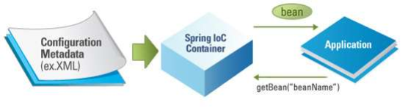
Dependency Injection
IoC Container
• The Spring container (IoC Container) is at the core of the Spring Framework.
• The container will create the objects, wire them together, configure them, and manage their complete lifecycle from creation till destruction.
7

Slide 38
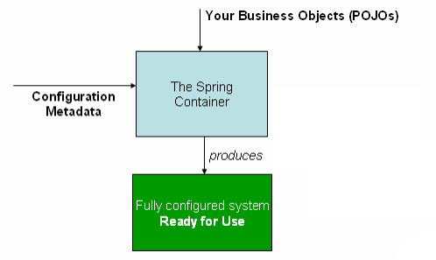
Dependency Injection
IoC Container
• The container gets its instructions on what objects to instantiate, configure, and assemble by reading configuration metadata provided.
• The configuration metadata can be represented either by;
• XML,
• Java annotations,
• Java code.
8

Slide 39
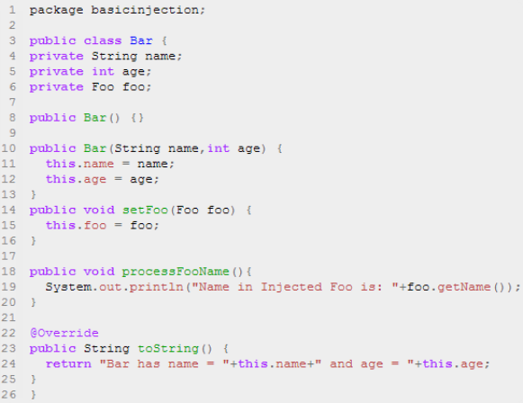
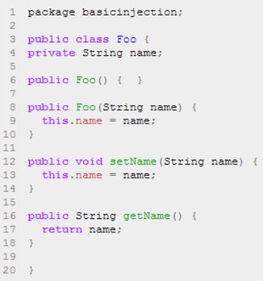
Dependency Injection
Code Example
To instantiate the above classes, one way is to do the usual new operator like new Foo() or new Bar() OR we can use the Spring dependency injection to instantiate these classes and set the properties accordingly.
9

Slide 40
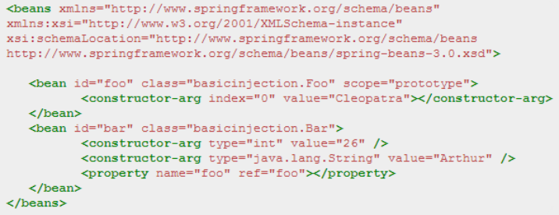


Dependency Injection
Code Example
Foo f = new Foo("Cleopatra");
Bar b = new Bar("Arthur",26); b.setFoo(f);
10

Slide 41
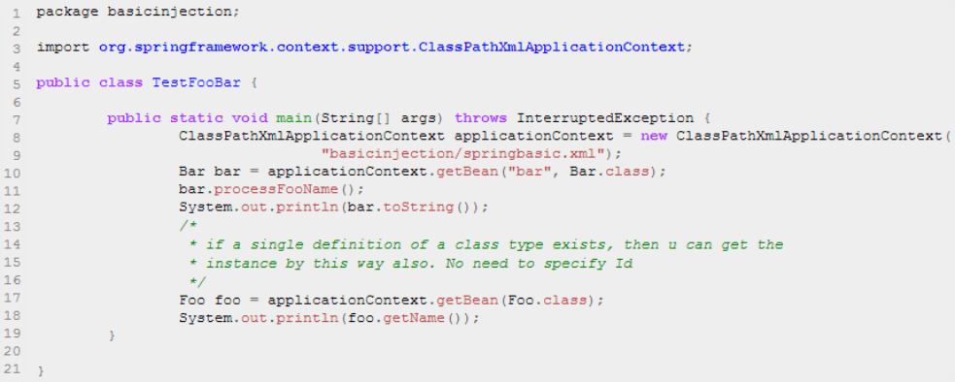
Dependency Injection
Code Example
Spring's ClassPathXmlApplicationContext is the commonly used object that hold the information of all the beans that it instantiates.
11

Slide 42
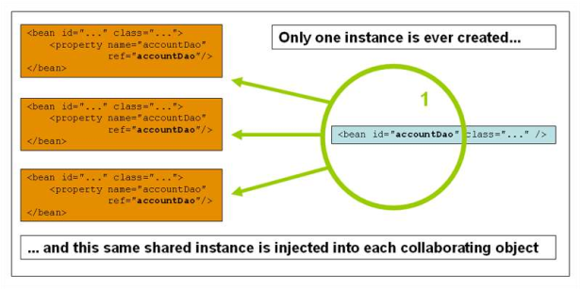
Dependency Injection
Bean Scopes
Scope | Description
Singleton | (Default) Scopes a single bean definition to a single object instance per Spring IoC container.
Prototype | Scopes a single bean definition to any number of object instances.
12

Slide 43



Inversion Of Control (IOC) and Dependency Injection
• These are the design patterns that are used to remove dependency from the programming code. They make the code easier to test and maintain. Let's understand this with the following code:
class Employee{ Address address; Employee(){ address=new Address();
} }
• In such case, there is dependency between the Employee and Address (tight coupling).

Slide 44
• In the Inversion of Control scenario, we do this something like this:
class Employee{
Address address; Employee(Address address){ this.address=address;
} }
• Thus, IOC makes the code loosely coupled. In such case, there is no need to modify the code if our logic is moved to new environment.
• In Spring framework, IOC container is responsible to inject the dependency. We provide metadata to the IOC container either by XML file or annotation.
• Advantage of Dependency Injection
– makes the code loosely coupled so easy to maintain
– makes the code easy to test

Slide 45

Spring Framework
Spring MVC Framework

Slide 46
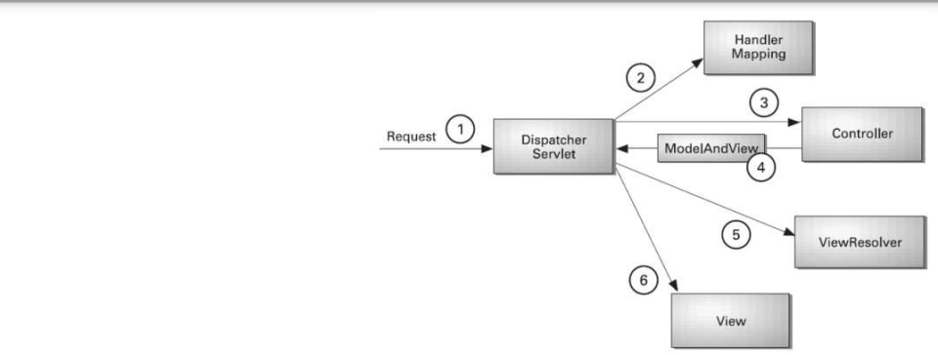
4.
Spring MVC Framework
❖ Spring MVC
The Spring Web MVC framework provides Model-View-Controller (MVC) architecture and ready components that can be used to develop flexible and loosely coupled web applications.
As displayed in the figure, all the incoming request is intercepted by the DispatcherServlet that works as the front controller. The DispatcherServlet gets
entry of handler mapping from the xml file and forwards the request to the controller. The controller returns an object of ModelAndView. The DispatcherServlet checks the entry of view resolver in the xml file and invokes the specified view component.

Slide 47
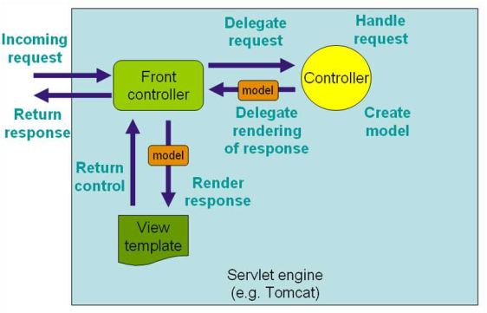
Spring MVC
• The Spring web MVC framework provides model-view-controller architecture and ready components that can be used to develop flexible and loosely coupled web applications.
• The MVC pattern results in separating the different aspects of the application (input logic, business logic, and UI logic), while providing a loose coupling between these elements.
24

Slide 48
Spring MVC
MVC Bean Scopes
Scope | Description
Request | Scopes a single bean definition to the lifecycle of a single HTTP request; that is, each HTTP request has its own instance of a bean created off the back of a single bean definition. Only valid in the context of a web- aware Spring ApplicationContext.
Session | Scopes a single bean definition to the lifecycle of an HTTP Session. Only valid in the context of a web- aware Spring ApplicationContext.
Global Session | Scopes a single bean definition to the lifecycle of a global HTTP Session. Typically only valid when used in a portlet context. Only valid in the context of a web-aware SpringApplicationContext.
Application | Scopes a single bean definition to the lifecycle of a ServletContext. Only valid in the context of a web- aware Spring ApplicationContext.
25

Slide 49
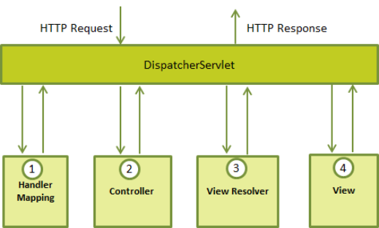
Spring MVC
The DispatcherServlet
• The Spring Web model-view-controller (MVC) framework is designed around a DispatcherServlet that handles all the HTTP requests and responses.
26

Slide 50
Spring MVC
Web.xml
• You need to map requests that you want the DispatcherServlet to handle, by using a URL mapping in the web.xml file.
<?xml version="1.0" encoding="UTF-8"?>
<web-app>
<display-name>Example</display-name>
<context:component-scan base-package="com.proj.web" />
<context-param>
<param-name>contextConfigLocation</param-name> <param-value>
/WEB-INF/context/example-general-context.xml
</param-value> </context-param>
<listener>
<listener-class>
org.springframework.web.context. ContextLoaderListener
</listener-class> </listener>
<servlet>
<servlet-name>spring</servlet-name> <servlet-class>
org.springframework.web.servlet.DispatcherServlet
</servlet-class> <init-param>
<param-name>contextConfigLocation</param-name>
<param-value>/WEB-INF/example-servlet.xml</param-value> </init-param>
<load-on-startup>1</load-on-startup> </servlet>
<servlet-mapping>
<servlet-name>spring</servlet-name>
<url-pattern>/</url-pattern> </servlet-mapping>
</web-app>
27

Slide 51
Spring MVC
Servlet.xml
• Now, let us check the required configuration for example-servlet.xml file, placed in your web application's WebContent/WEB-INF directory:
<context:component-scan base-package="com.proj.web.controller" />
<bean id="viewResolver" class="org.springframework.web.servlet.view.UrlBasedViewResolver"> <property name="viewClass" value="org.springframework.web.servlet.view.JstlView" /> <property name="prefix" value="/WEB-INF/view/" />
<property name="suffix" value=".jsp" />
</bean>
<mvc:annotation-driven />
</beans>
28

Slide 52
Spring MVC
Controller & View
• HomeController.java:
@Controller
public class HomeController {
@RequestMapping(value = { "/", "/home" },
method = RequestMethod.GET)
public String showHomePage(ModelMap model) {
model.addAttribute("message", "Hello
Spring MVC Framework!");
return "home";
} }
• Home.jsp
<html> <head>
<title>Here is home page</title> </head>
<body>
<h2>${message}</h2>
</body> </html>
29

Slide 53
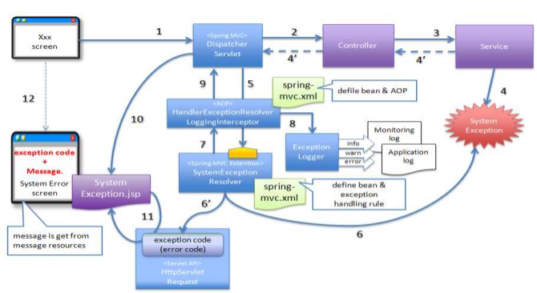
Flow diagram Spring framework

Slide 54
Spring Framework
Development Tools

Slide 55
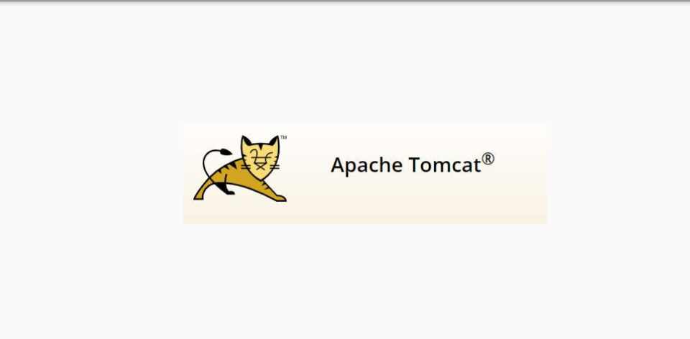
2.
Development Tools

Slide 56
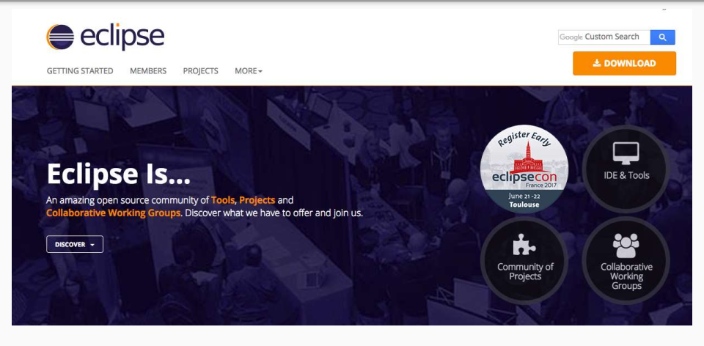
2.
Development Tools

Slide 57
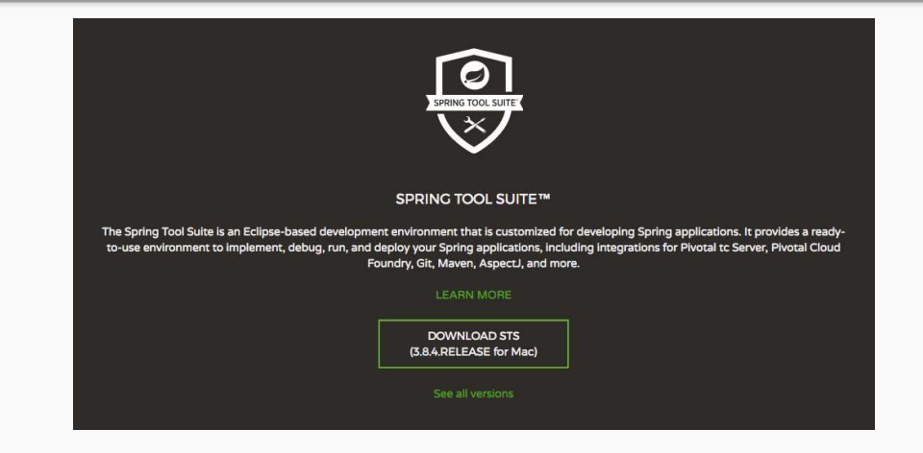
2.
Development Tools

Slide 58
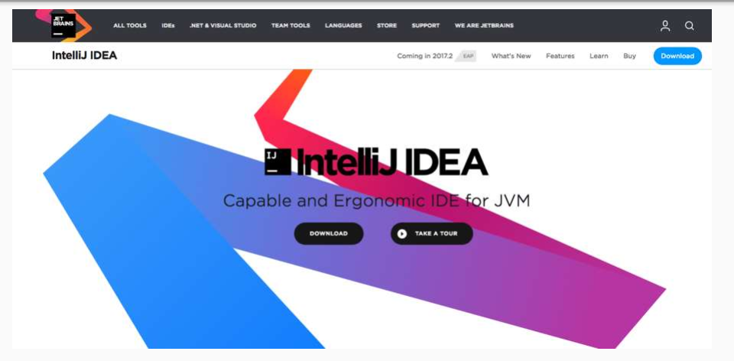
2.
Development Tools

Slide 59
2.
Development Tools - Source
Spring Tool Suite:
Apache Tomcat: http://tomcat.apache.org/download-80.cgi

Slide 60
Spring Framework
3. Introduction to Maven in Spring Framework

Slide 61
3.
Introduction to Maven in Spring Framework
Apache Maven is a software project management and comprehension tool. Based on the concept of a project object model (POM), Maven can manage a project's build, reporting and documentation from a central piece of information.
POM - Project Object Model :
It is an XML file that contains information about the project and configuration details used by Maven to build the project.
Some of the configuration that can be specified in the POM are the project dependencies, the plugins or goals that can be executed, the build profiles, and so on. Other information such as the project version, description, developers, mailing lists and such can also be specified.

Slide 62
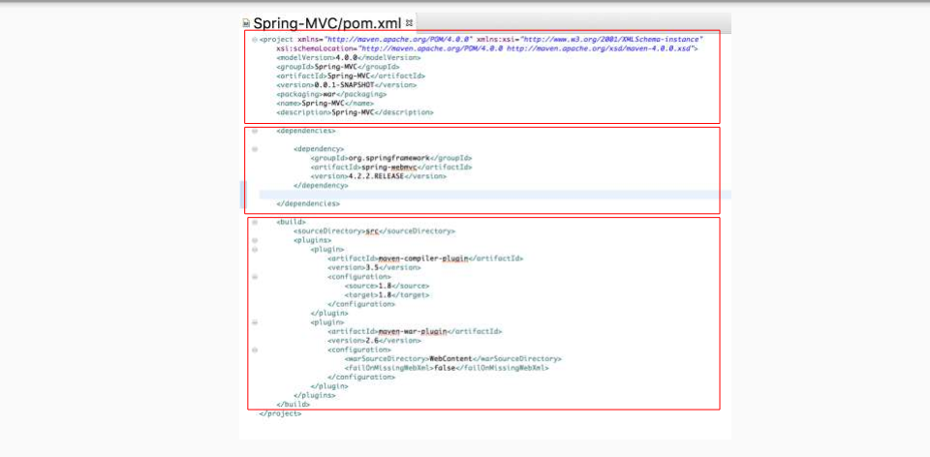
3.
Introduction to Maven in Spring Framework

Slide 63
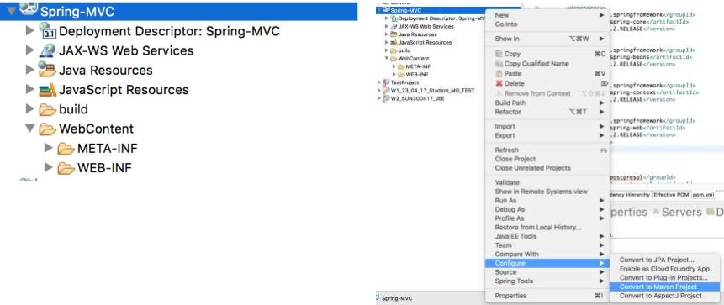
4.1
Spring MVC Framework Example - XML Configuration
Dynamic Web Project
Convert to Maven Project

Slide 64
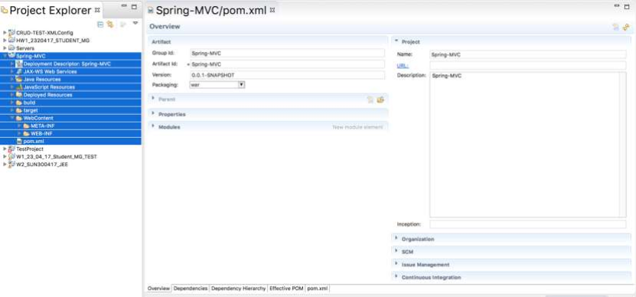
4.1
Spring MVC Framework Example - XML Configuration
Converted to Maven Project

Slide 65
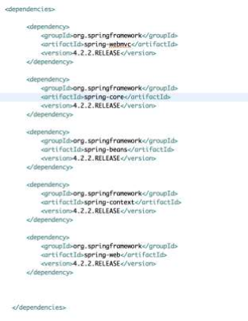
4.1
Spring MVC Framework Example - XML Configuration
Add Spring Framework Dependencies to pom.xml
❖ spring-webmvc ❖ spring-core ❖ spring-beans ❖ spring-context ❖ spring -web

Slide 66
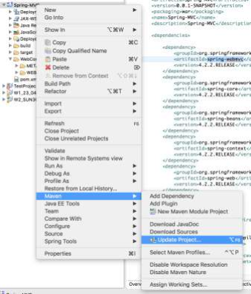
4.1
Spring MVC Framework Example - XML Configuration
Update Maven Dependency :

Slide 67
4.1
Spring MVC Framework Example - XML Configuration
Configuration in web.xml in WEB-INF:
<web-app version="3.1" xmlns="http://xmlns.jcp.org/xml/ns/javaee" xmlns:xsi="http://www.w3.org/2001/XMLSchema-instance"
xsi:schemaLocation="http://xmlns.jcp.org/xml/ns/javaee http://xmlns.jcp.org/xml/ns/javaee/web-app_3_1.xsd">
<servlet>
<servlet-name>dispatcherServlet</servlet- name>
<servlet-class>
org.springframework.web.servlet.DispatcherServlet </servlet-class>
<init-param>
<param-name>contextConfigLocation</param-name>
<param-value>/WEB-INF/springmvc-servlet.xml</param-value> </init-param>
<load-on-startup>1</load-on-startup> </servlet>
<servlet-mapping>
<servlet-name>dispatcherServlet</servlet- name>
<url-pattern>/</url-pattern> </servlet-mapping>
</web-app>
Theweb.xml file will be kept in the/WEB-INF directory of your web application. Upon initialization ofmyDispatcherServletDispatcherServlet, the framework will try to load the application context from a file named [servlet-name]-servlet.xmllocated in the application's WebContent/WEB-INF directory. In this case, our file will be springmvc-servlet.xml.

Slide 68
4.1
Spring MVC Framework Example - XML Configuration
contextConfigLocation in WEB-INF: springmvc-servlet.xml
<?xml version="1.0" encoding="UTF-8"?>
<beans xmlns="http://www.springframework.org/schema/beans" xmlns:xsi="http://www.w3.org/2001/XMLSchema-instance" xmlns:context="http://www.springframework.org/schema/context" xmlns:mvc="http://www.springframework.org/schema/mvc"
xsi:schemaLocation="http://www.springframework.org/schema/beans http://www.springframework.org/schema/beans/spring-beans-4.0.xsd http://www.springframework.org/schema/context
http://www.springframework.org/schema/context/spring-context-4.0.xsd http://www.springframework.org/schema/mvc http://www.springframework.org/schema/mvc/spring-mvc-4.0.xsd">
<context:component-scan base-package="com.student" />
<context:annotation-config /> <mvc:annotation-driven />
<mvc:resources mapping="/**" location="/" />
<bean class="org.springframework.web.servlet.view.InternalResourceViewResolver"> <property name="prefix" value="/WEB-INF/pages/" />
<property name="suffix" value=".jsp" /> </bean>
</beans>

Slide 69
4.1
Spring MVC Framework Example - XML Configuration
contextConfigLocation in WEB-INF springmvc-servlet.xml
<context:component-scan base-package="com.student.app" />
<!--
tells spring to search project classpath for all classes under the package specified with base-package [com.student.app], and look at each class to see if it is annotated with specific Spring
annotations [@Controller, @Service, @Repository, @Component, etc..] and if it does then Spring will register the class with the bean factory as if you had typed in the xml configuration files.
-->
<context:annotation-config />
<!--
<context:annotation-config> is used to activate annotations in beans already registered in the application context (no matter if they were defined with XML or by package scanning).
<context:component-scan> can also do what <context:annotation-config> does but <context:component-scan> also scans packages to find and register beans within the application context.
-->

Slide 70
4.1
Spring MVC Framework Example - XML Configuration
contextConfigLocation in WEB-INF springmvc-servlet.xml
<mvc:annotation-driven />
<!-- says that we can define spring beans dependencies without actually having to specify a bunch of beans in xml or implement an interface or extend a base class or anything. For example, just by annotating a class with @Controller (as we did above) , spring will know that the specified class contains methods that will handle HTTP requests, no need to define that as a bean in xml.
-->

Slide 71
4.1
Spring MVC Framework Example - XML Configuration
Create bean in contextConfigLocation in WEB-INF springmvc-servlet.xml
<!-- declare datasource bean -->
<bean id="dataSource" class="org.springframework.jdbc.datasource.DriverManagerDataSource"> <property name="driverClassName" value="org.postgresql.Driver" /> <property name="url" value="jdbc:postgresql://localhost:5432/test" /> <property name="username" value="postgres" />
<property name="password" value="123" /> </bean>
<!-- declare beans -->
<bean id="studentDao" class="com.hrd.app.model.dao.StudentDao"> <!-- <property name="dataSource" ref="dataSource"/> -->
<constructor-arg ref="dataSource"/> </bean>

Slide 72
4.1
Spring MVC Framework Example - XML Configuration
Controller :
@Controller: annotation is an annotation used in Spring MVC framework (the component of Spring Framework used to implement Web Application). The @Controller annotation indicates that a particular class serves the role of a controller. The @Controller annotation acts as a stereotype for the annotated class, indicating its role. The dispatcher scans such annotated classes for mapped methods and detects @RequestMapping annotations.
@RequestMapping: is one of the most widely used Spring MVC annotation. org.springframework.web.bind.annotation.RequestMapping annotation is used to map web requests onto specific handler classes and/or handler methods.

Slide 73
4.2
Spring MVC Framework Example - Java Configuration
Bootstraps : HRDBootstrap.java
implements WebApplicationInitializer
// 1. Create AnnotationConfigWebApplicationContext Object
AnnotationConfigWebApplicationContext servletContext = new AnnotationConfigWebApplicationContext();
// 2. Add the Configuration class
servletContext.register(HRDWebConfiguraion.class);
// 3. Create DispatcherServlet, add it to container, and assign it to the servletRegistration
ServletRegistration.Dynamic dispatcherServlet =
container.addServlet("MyspringDispatcher", new DispatcherServlet(servletContext));
dispatcherServlet.addMapping("/"); dispatcherServlet.setLoadOnStartup(1);

Slide 74
Spring MVC Framework Example - Java Configuration
Configurations : HRDWebConfiguraion.java
@Configuration: tags the class as a source of bean definitions for the application context.
@EnableWebMvc: is used to enable Spring MVC. is equivalent to <mvc:annotation-driven /> in XML. It enables support for
@Controller-annotated classes that use @RequestMapping to map incoming requests to a certain method.
@ComponentScan : tells Spring to look for other components, configurations, and services in the the com.therealdanvega package.
@Bean
public ViewResolver viewRsolver(){
InternalResourceViewResolver resolver = new InternalResourceViewResolver(); resolver.setPrefix("/WEB-INF/views/");
resolver.setSuffix(".jsp"); return resolver;
}

Slide 75
4.2
Spring MVC Framework Example - Java Configuration
Create Bean in Java Configuration
@Bean: annotation returns an object that spring should register as bean in applicationcontext.
@Bean
public DataSource getDataSource(){
DriverManagerDataSource dataSource = new DriverManagerDataSource(); dataSource.setDriverClassName(environment.getProperty("KA.dataSourcel.driverClassName")); dataSource.setUrl(environment.getProperty("KA.dataSourcel.url")); dataSource.setUsername(environment.getProperty("KA.dataSourcel.username")); dataSource.setPassword(environment.getProperty("KA.dataSourcel.password"));
return dataSource; }
@Bean StudentDao studentDao(){ return new StudentDao();
}

Slide 76
Spring Framework
Getting Started with Spring Boot

Slide 77
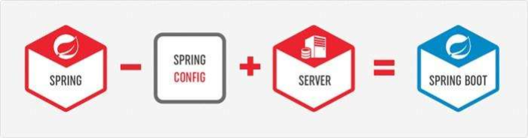
5.
Getting Started with Spring Boot
Spring Boot is a Framework from “The Spring Team” to ease the bootstrapping and development of new Spring Applications. Most Spring Boot applications need very little Spring configuration.

Slide 78
5.
Getting Started with Spring Boot
Why Spring Boot?
● No requirement for XML or annotations configuration
● provide some defaults to quick start new projects
● It is very easy to integrate Spring Boot Application with its Spring Ecosystem like Spring JDBC, Spring ORM, Spring Data, Spring Security etc.
● to reduce Development, Unit Test and Integration Test time and to ease the development of Production ready web applications very easily compared to existing Spring Framework, which really takes more time.

Slide 79
5.
Getting Started with Spring Boot
System Requirement
By default, Spring Boot 1.5.3.RELEASE requires Java 7 and Spring Framework 4.3.8.RELEASE or above. You can use Spring Boot with Java 6 with some additional configuration.
Although you can use Spring Boot with Java 6 or 7, spring document generally recommend Java 8 if at all possible.

Slide 80

5.
Getting Started with Spring Boot
Create a Spring Boot Project
<!-- Inherit defaults from Spring Boot -->
<parent> <groupId>org.springframework.boot</groupId> <artifactId>spring-boot-starter-parent</artifactId> <version>2.7.2</version>
</parent>
Maven project POM will simply inherit from the spring-boot-starter-parent project.
- provides useful Maven defaults.
- provides dependency-management section so that you can omit version tags for dependencies you would need for your own project.
-
Adds a ‘run’ goal that we can use on command-line to start the application [mvn

Slide 81
5.
Getting Started with Spring Boot
Create a Spring Boot Project
<!-- Add Spring MVC Dependency - This is a web application-->
<dependency <groupId>org.springframework.boot</groupId> <artifactId>spring-boot-starter-web</artifactId>
</dependency>
<!-- Add Tomcat Dependency - Tomcat embedded container -->
<dependency> <groupId>org.springframework.boot</groupId> <artifactId>spring-boot-starter-tomcat</artifactId> <scope>provided</scope>
</dependency>

Slide 82
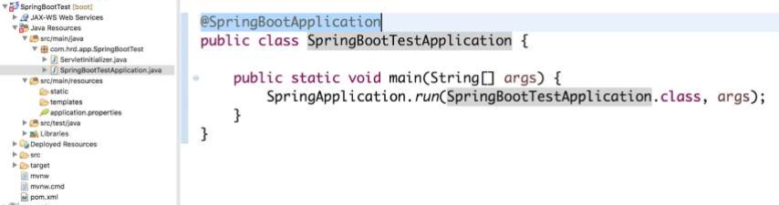
5.
Getting Started with Spring Boot
Create a Spring Boot Project
The Spring Boot Application Annotation is a convenience annotation that adds all of the following: @Configuration tags the class as a source of bean definitions for the application context. @EnableAutoConfiguration tells Spring Boot to start adding beans based on class path settings, other beans, and various property settings.
@ComponentScan tells Spring to look for other components, configurations, and services in the the com.hrd.app package.

Slide 83
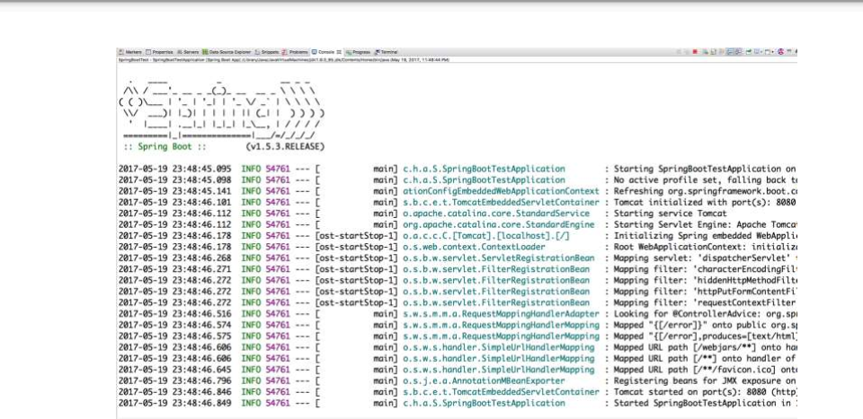
5.
Getting Started with Spring Boot
Run As: Spring Boot App

Slide 84
5.
Getting Started with Spring Boot
Adding View - JSP
<!-- Need this to compile JSP -->
<dependency> <groupId>org.apache.tomcat.embed</groupId> <artifactId>tomcat-embed-jasper</artifactId> <scope>provided</scope>
</dependency>
Configuring JSP ViewResolver : /src/main/resources/application.properties spring.mvc.view.prefix: /WEB-INF/jsp/
spring.mvc.view.suffix: .jsp

Slide 85
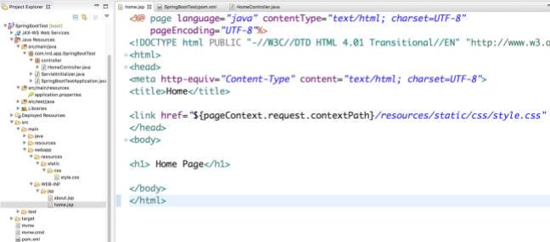
5.
Getting Started with Spring Boot
Adding View - JSP
JSP Files :
- src/main/webapp/WEB-INF/jsp/home.jsp
- src/main/webapp/WEB-INF/jsp/about.jsp

Slide 86
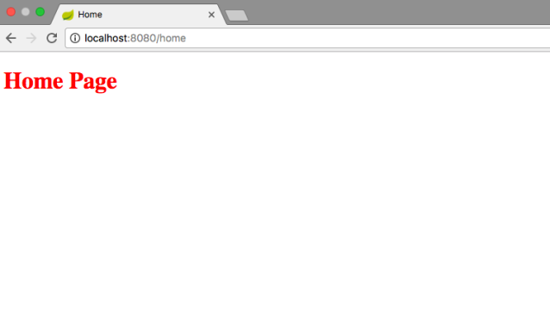
5.
Getting Started with Spring Boot
Run As: Spring Boot App

Slide 87

Spring Framework
6.
Spring Core Technologies

Slide 88

6.
Spring Core Technologies
Inversion of Control (IoC) and Dependency Injection (DI):
What is Inversion of Control (IoC)?
● IoC is the spring container that contains the objects (Beans).
● IoC makes your code more portable, more testable, and more manageable and keeps component configuration.
What is Dependency Injection (DI) ?
● DI is use to inject object dependencies from IoC.
Three ways to use Dependency Injection (DI) ?
● Setter Injection
● Constructor Injection
●
Field Injection

Slide 89
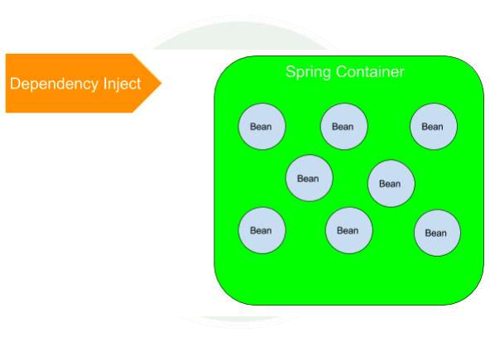
6.
Spring Core Technologies
Inversion of Control (IoC) and Dependency Injection (DI):

Slide 90
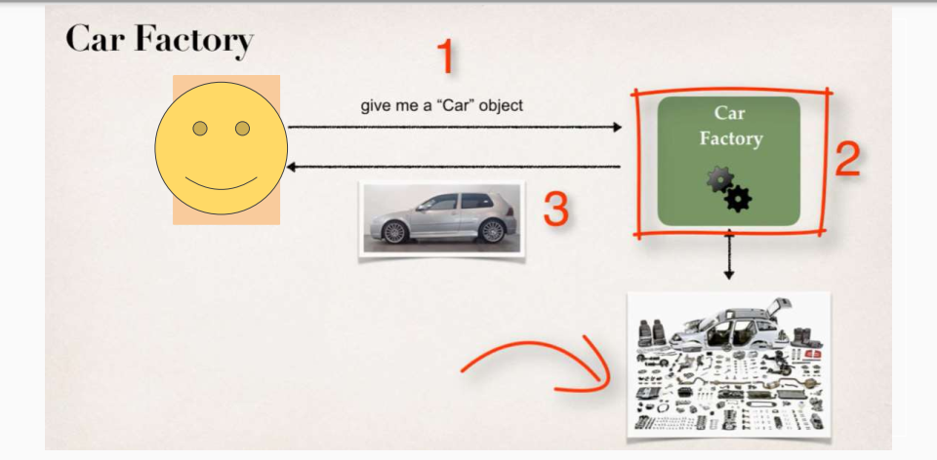
6.
Spring Core Technologies

Slide 91
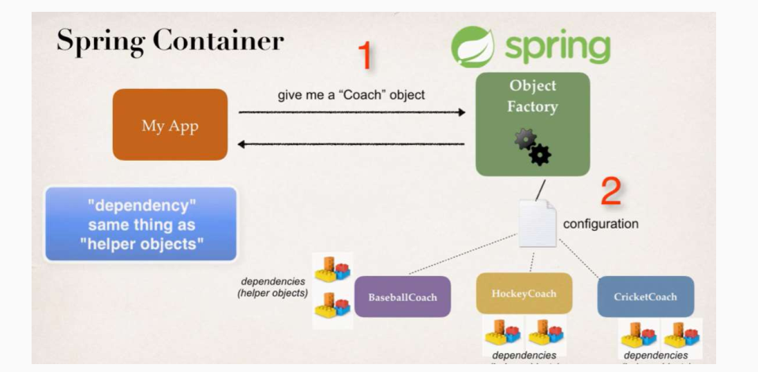
6.
Spring Core Technologies
Vehicl e
Car
Truck
Bus

Slide 92
6.
Spring Core Technologies
Inversion of Control (IoC) and Dependency Injection (DI):
To create bean by java base and xml configuration:
@Bean(name=”userRepositoryImpl”)
public UserRepositoryImpl userRepositoryImpl(){ return new UserDAO();
}
@Bean(name=”userServiceImpl”)
public UserServiceImpl userRepositoryImpl(){ return new UserDAO();
}
<bean id=”userRepositoryImpl” class=”com.spring.UserRepositoryImpl”> </bean/>
<bean id=”userServiceImpl” class=”com.spring.UserServiceImpl”> </bean/>

Slide 93
6.
Spring Core Technologies
Inversion of Control (IoC) :
Example 1 Inversion of Control with XML configuration:
1. Add Library to Spring to project: commons-logging-api
spring-beans spring-context spring-core Spring-expression
2. Define bean in applicationContext - XML Configuration
<!-- Define Bean -->
<bean id="car" class="io.spring.ioc.Car">
</bean>
<bean id="truck" class="io.spring.ioc.Truck">
</bean>

Slide 94
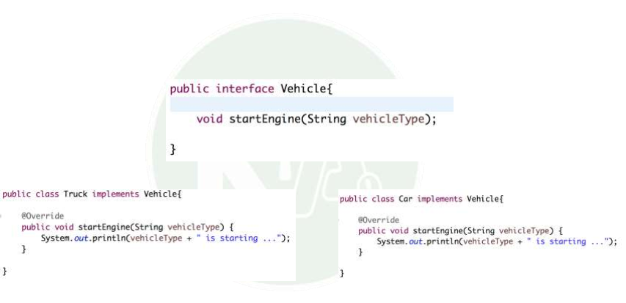
6.
Spring Core Technologies
Inversion of Control (IoC) :
Example 1 Inversion of Control with XML configuration:

Slide 95
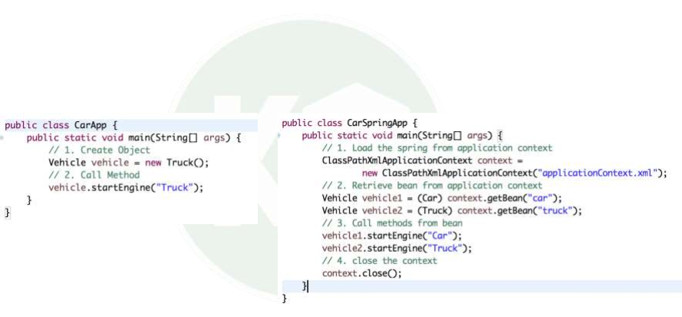
6.
Spring Core Technologies
Inversion of Control (IoC) :
Example 1 Inversion of Control with XML configuration:
Simple Java Style
Spring - Inversion of Control Style

Slide 96
6.
Spring Core Technologies
Inversion of Control (IoC) and Dependency Injection (DI):
Example 2 : Inversion of Control and Dependency Injection with XML configuration:

Slide 97
6.
Spring Core Technologies
Inversion of Control (IoC) :
Example 2 : Inversion of Control and Dependency Injection with XML configuration:
1. Add Library to Spring to project: commons-logging-api
spring-beans spring-context spring-core Spring-expression

Slide 98
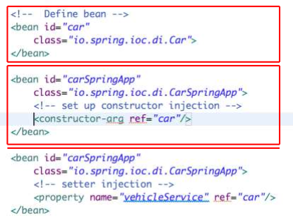



6.
Spring Core Technologies
Inversion of Control (IoC) : Example 2 : Inversion of Control and Dependency Injection with XML configuration: 2. Define Bean in XML Configuration file Define Bean Car Define Bean CarSpringApp and Inject Car Bean by Constructor Injection Define Bean CarSpringApp and Inject Car Bean by Setter Injection

Slide 99
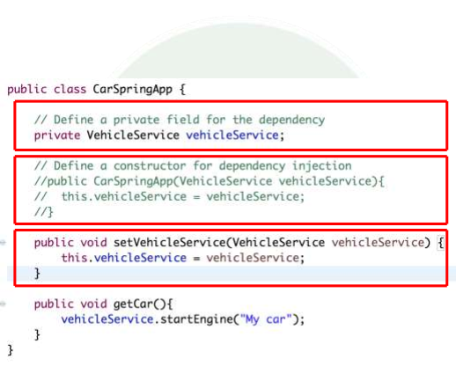

6.
Spring Core Technologies
Inversion of Control (IoC) and Dependency Injection (DI): Example 2 : Inversion of Control and Dependency Injection with XML configuration: Field Injection Constructor Injection Setter Injection
 | Used Object VehicleService after injected

Slide 100
6.
Spring Core Technologies
Spring Injection with @Resource, @Autowired and @Inject
The Spring Injection annotation is used to specify bean dependency that will be injected by the Spring Container at run time.
@Resource – Defined in the javax.annotation package and part of Java @Inject – Defined in the javax.inject package and part of Java
@Autowired – Defined in the package org.springframework.beans.factory and part of Spring framework.

Slide 101
6.
Spring Core Technologies
Inversion of Control (IoC) and Dependency Injection (DI):
There’re three ways to use Dependency Injection:
● | Constructor Injection
 | Ex: @Autowired | private UserService userService;
public DataController(UserService userService){ this.userService = userService;
}
● | Setter Injection
 | Ex: | private UserService userService; @Autowired public void setUserService(UserService userService){
this.userService = userService; }
● | Field Injection
 | Ex : | @Autowired private UserService userService;

Slide 102
6.
Spring Core Technologies
Spring Injection with @Resource, @Autowired and @Inject
@Autowired and @Inject
● Matches by Type
● Restricts by Qualifiers
● Matches by Name
@Resource
● Matches by Name
● Matches by Type
● Restricts by Qualifiers (ignored if match is found by name)
The behaviour of @Autowired annotation is similar to the @Inject annotation. The only difference is that the @Autowired annotation is part of the Spring framework.
The @Inject annotation belongs to the JSR-330 annotations collection. To use @Inject Annotation you must declared maven :
<dependency> <groupId>javax.inject</groupId> <artifactId>javax.inject</artifactId>
<version>1</version> </dependency>

Slide 103
6.
Spring Core Technologies
Spring Injection with @Resource, @Autowired and @Inject
/*
* Field Injection */
// Match by Type
@Inject
private UserService userService1;
// Match by Qualifier
@Inject @Qualifier("userServiceImpl") private UserService userService2;
// Match by Name
@Inject
private UserService userServiceImpl;

Slide 104
Spring Framework
7. POJO Programming Model With Stereotype Annotations

Slide 105

7. POJO Programming Model with Stereotype Annotations
POJO stands for Plain Old Java Objects, and denotes regular Java classes that are not tied up to any interface.
The benefits of POJO Programming Model:
❖ The coding application classes is very fast and simple. This is because classes don’t need to
depend on any particular API, implement any interface, extend from a particular framework class,
or create any special callback methods until you really need them.
Easy to Upgrading to a new version or switching to a different framework becomes easier and less risky.
Make testing easier.
POJO programming is more object-oriented, as POJO classes usually encapsulate behavior and
properties; older EJB programming model was more procedural.

Slide 106
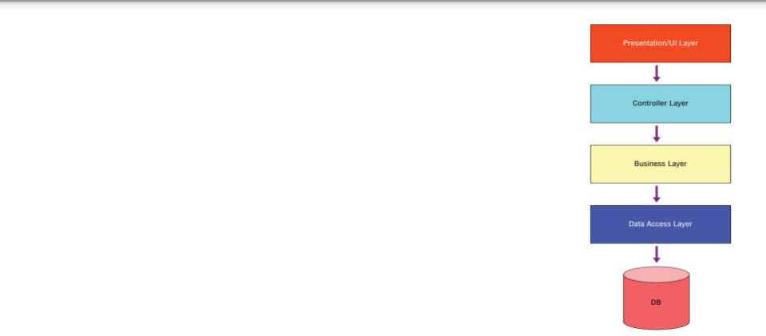

7. POJO Programming Model with Stereotype Annotations
★
★
★
★
Data Access Layer
○ Used for actually interacting with database and accessing data
Business Layer
○ Used for adding in specific business rules, processing and manipulating data and other calculations.
○ Handles all of the business rules, calculations and actual logic within the application. It may often use some of the objects retrieved from Data Access Layer. This layer would actually consist of more actual code and conditions that would be used to apply in business rules.
Controller Layer
○ It acts as an interface between Business Layer and UI Layer components to process all the business logic and incoming requests, manipulate data using the service component and interact with the Views to render the final output.
Presentation/UI Layer
○ The View component is used for all the UI logic of the application.

Slide 107
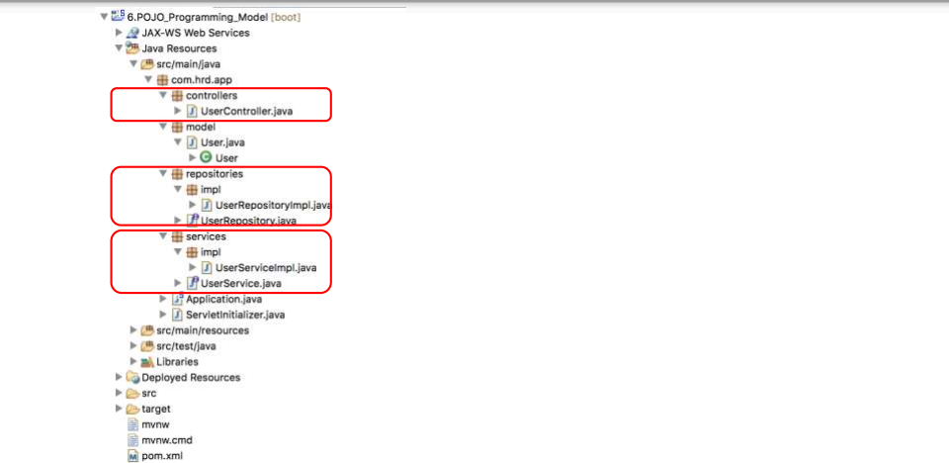
7. POJO Programming Model with Stereotype Annotations
Controller Layer
Data Access Layer
Business Layer

Slide 108
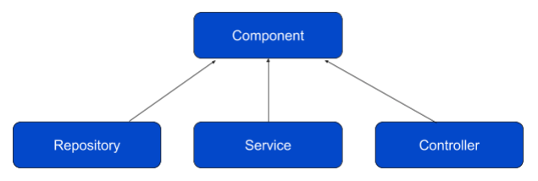
7. POJO Programming Model with Stereotype Annotations -
Stereotype annotations
Package org.springframework.stereotype
@Component: annotation which is a parent stereotype annotation can be used to define all beans. @Controller: indicates that an annotated class serves the role of a controller in Spring MVC.
@Service: Annotate all your service classes with @Service annotation, which contains all your business logic. @Repository: A repository class serves in the persistence layer of the application as a Data Access Objects (DAO) that contains all your database access logic.

Slide 109
Spring Framework
8. Using Thymeleaf in Spring Boot

Slide 110
8. Using Thymeleaf in Spring Boot
Thymeleaf is Open-Source Software, licensed under the Apache License 2.0.
It is a Java Library that can work both in web (Servlet-based) and non-web environments. It is better suited for serving XML / XHTML / HTML5 template engine at the view layer of MVC-based web applications. It provides full Spring Framework integration.
Thymeleaf aims to be complete substitute for JSP / JSTL / Apache Tiles, and implements the concept of Natural Template (Template files that can be directly opened in browsers and still display correctly as web pages).

Slide 111
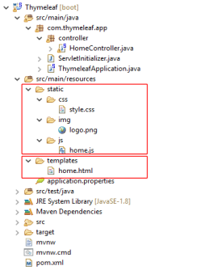
8. Using Thymeleaf in Spring Boot
Get Started Thymeleaf with Spring Boot:
Declares spring-boot-starter-thymeleaf
<dependency> <groupId>org.springframework.boot</groupId> <artifactId>spring-boot-starter-
thymeleaf</artifactId> </dependency>
By default, Spring Boot Configures the Thymeleaf template engine to read template files from
- src/main/resources/templates : for template files (HTML)
- src/main/resources/static : for static files (css, javascript or image ...)
Static Files
Template Files

Slide 112
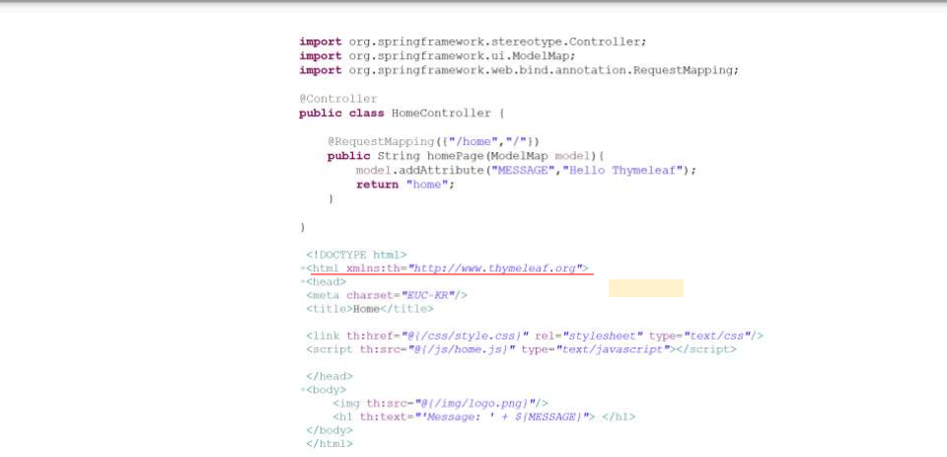
8. Using Thymeleaf in Spring Boot
Get Started Thymeleaf with Spring Boot:
Create Controller:
set a XML Namespace for Thymeleaf. This is important as you start to use the Thymeleaf extensions.
Create HTM File in src/main/resources/template/

Slide 113
8. Using Thymeleaf in Spring Boot - ThymeleafAutoConfiguration
❖
# THYMELEAF ( spring.thymeleaf.cache=true # Enable template caching.
spring.thymeleaf.check-template=true # Check that the template exists before rendering it.
spring.thymeleaf.check-template-location=true # Check that the templates location exists.
spring.thymeleaf.content-type=text/html # Content-Type value. spring.thymeleaf.enabled=true # Enable MVC Thymeleaf view resolution.
spring.thymeleaf.encoding=UTF-8 # Template encoding.
spring.thymeleaf.excluded-view-names= # Comma-separated list of view names that should be excluded
from resolution.
spring.thymeleaf.mode=HTML5 # Template mode to be applied to templates. See also
StandardTemplateModeHandlers.
spring.thymeleaf.prefix=classpath:/templates/ # Prefix that gets prepended to view names when building a
URL.
spring.thymeleaf.suffix=.html # Suffix that gets appended to view names when building a URL.
spring.thymeleaf.template-resolver-order= # Order of the template resolver in the chain.
spring.thymeleaf.view-names= # Comma-separated list of view names that can be resolved.

Slide 114
8. Using Thymeleaf in Spring Boot - Customize TemplateResolver
❖
Customize TemplateResolver by configuring in application.properties file
➢ spring.thymeleaf.mode=LEGACYHTML5 #remove strict checking and add dependency nekohtml
<dependency> <groupId>org.springframework.boot</groupId> <artifactId>spring-boot-devtools</artifactId>
</dependency>
➢ spring.thymeleaf.prefix=classpath:templates/ # Prefix that gets prepended to view names when
building a URL.

Slide 115
8. Using Thymeleaf in Spring Boot + Automatic Restart
Automatic Restart
Applications that use spring-boot-devtools will automatically restart whenever files on the classpath change. This can be a useful feature when working in an IDE as it gives a very fast feedback loop for code changes. By default, any entry on the classpath that points to a folder will be monitored for changes. Note that certain resources such as static assets and view templates do not need to restart the application.
<dependency> <groupId>org.springframework.boot</groupId> <artifactId>spring-boot-devtools</artifactId>
</dependency>

Slide 116
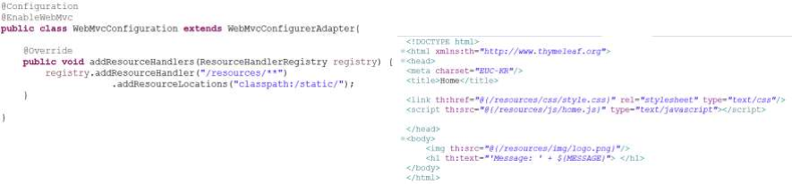
8. Using Thymeleaf in Spring Boot + ResourceHandlerRegistry
Static Resources
It is the way to point to the location of resources with a specific public URL pattern.
Example: the following line will serve all requests for resources with a specific public URL pattern. “/resources/**” by searching in the “/resources/” directory under the root folder in our web application.
ResourceHandlerRegistry: It is used to configure ResourceHttpRequestHandlers for serving static resources from the classpath, the WAR, or the file system. We can configure the ResourceHandlerRegistry programmatically inside configuration class.
❖ Static Resources store in the Project

Slide 117
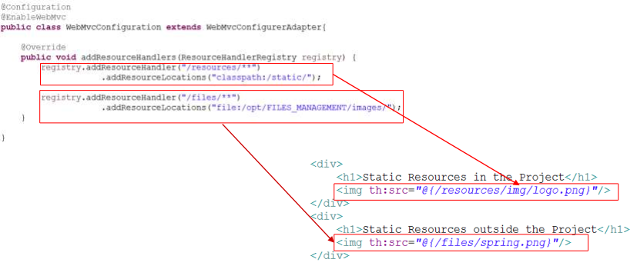
8. Using Thymeleaf in Spring Boot + ResourceHandlerRegistry
Static Resources
❖ Static Resources store outside the Project

Slide 118
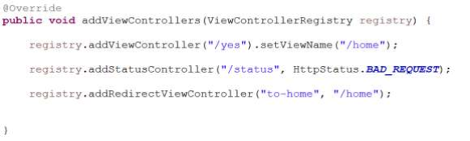
8. Using Thymeleaf in Spring Boot + ViewControllerRegistry
ViewControllerRegistry
❖ | addViewController(urlPath) : Map a view controller to the given URL path (or pattern) in other to render a response with a pre-configured status code and view. addStatusController(urlPath, HttpStatus) : Map a simple controller to the given URL path (or pattern) in order to set the response status to the given code without rendering a body. addRedirectViewController(urlPath, statusCode) : Map a view controller to the given URL path (or pattern) in other to redirect to another URL.
❖
❖

Slide 119
8. Using Thymeleaf in Spring Boot - Standard Expression Syntax
Standard Expression Syntax
Simple Expression Syntax
- Variable Expressions: ${...}
- Selection Variable Expressions: *{...}
- Message Expressions: #{...}
- Link URL Expressions: @{...}
- Fragment Expressions: ~{...}
Conditional Operation
- if-then: (if) ? (then)
- if-then-else: (if) ? (then) : (else)
- Default: (value) ?: (defaultvalue)
Text operations
- String concatenation: +
- Literal substitutions: |The name is ${name}|
Boolean operations:
- Binary operators: and, or
- Boolean negation (unary operator): !, not
Comparisons and equality
- Comparators: >, <, >=, <= (gt, lt, ge, le)
- Equality operators: ==, != (eq, ne)
Arithmetic operations
- Binary operators: +, -, *, /, %
- Minus sign (unary operator): -
Literals
- Text literals: 'one text', 'Another one!',…
- Number literals: 0, 34, 3.0, 12.3,…
- Boolean literals: true, false
- Null literal: null
- Literal tokens: one, sometext, main,…
Special tokens
- No-Operation: _

Slide 120
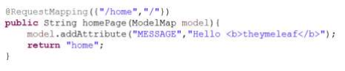
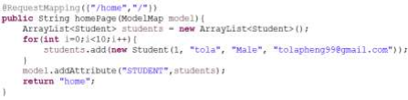
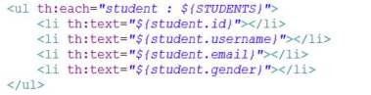
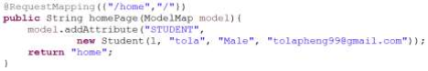


8. Using Thymeleaf in Spring Boot
Variable Expressions with th:text & th:utext attribute
Simple Attributes
Collection Attributes
Object Attributes
Expressions on Selections

Slide 121

8. Using Thymeleaf in Spring Boot
Link URLs Expression with th:href attribute
** URL path: ~/student/15/detail
** URL query: ~/student/detail?student-id=15
** URI path & query: ~/student/15/school/20/page=3&limit=20

Slide 122



8. Using Thymeleaf in Spring Boot
Conditional Evaluation
if unless
switch case

Slide 123


8. Using Thymeleaf in Spring Boot
Setting Attribute Values with th:attr
Setting the value of any attributes
Fixed-value boolean attributes
Setting more than one value at a time
Appending and prepending

Slide 124


8. Using Thymeleaf in Spring Boot
Iteration - using th:each
Iteration
Iteration - Keeping iteration status

Slide 125


8. Using Thymeleaf in Spring Boot
Iteration - Keeping iteration status
Iteration - Optimizing through lazy retrieval of data

Slide 126


8. Using Thymeleaf in Spring Boot
Inlining & Remove Tag
Note that, while [[...]] corresponds to th:text (i.e. result will be HTML-escaped), [(...)] corresponds to th:utext and will not perform any HTML-escaping.
Text inlining and Remove Tag
JavaScript inlining

Slide 127

8. Using Thymeleaf in Spring Boot
Inlining with JavaScript
An important thing to note regarding JavaScript inlining is that this expression evaluation is intelligent and not limited to Strings. Thymeleaf will correctly write in JavaScript syntax the following kinds of objects:
● Strings
● Numbers
● Booleans
● Arrays
● Collections
● Maps
● Beans (objects with getter and setter methods)
Example:

Slide 128
8. Using Thymeleaf in Spring Boot + Handling Form
Thymeleaf Handling Form Submission

Slide 129


8. Using Thymeleaf in Spring Boot + Handling Form
Form input can be handled using the th:action=”@{url}” and th:object=”${object}” attributes.
- The th:action is used to provide the form action URL
- The th:object is used to specify an object to which the submitted form data will be bound. Individual fields are mapped using the th:field=”*{name}” attribute, where the name is the matching property of the object.
Create Class Student and Web Controller
The @ModelAttribute annotation binds the form fields to the
student object.

Slide 130

8. Using Thymeleaf in Spring Boot + Handling Form
Create Student Input form with Student class
Form input can be handled using the th:action=”@{url}” and th:object=”${object}” attributes.
- The th:action is used to provide the form action URL
- The th:object is used to specify an object to which the submitted form data will be bound. Individual fields are mapped using the th:field=”*{name}” attribute, where the name is the matching property of the object.

Slide 131
8. Using Thymeleaf in Spring Boot + Internalization i18n
Thymeleaf Internalization i18n

Slide 132


8. Using Thymeleaf in Spring Boot + Internalization i18n
We’re going to take a look at how we can add internationalization i18n to a Spring Boot application with thymeleaf Template Engine.
Defining the Message Sources
English
Khmer

Slide 133

8. Using Thymeleaf in Spring Boot + Internalization i18n
We’re going to take a look at how we can add internationalization i18n to a Spring Boot application with thymeleaf Template Engine.
Configuring in WebMvcConfiguration Class that extends WebMvcConfigurerAdapter

Slide 134
8. Using Thymeleaf in Spring Boot
Template Layout : Custom Layout Dialect

Slide 135
8. Using Thymeleaf in Spring Boot
Template Layout : Custom Layout Dialect
In our templates, we will often want to include parts from other templates, parts like footers, headers, menus…
In order to do this, Thymeleaf needs us to define these parts, “fragments”, for inclusion, which can be done using the th:fragment attribute.
Thymeleaf addresses that with custom dialects – you can build layouts using the Thymeleaf Standard Layout System or the Layout Dialect – which uses the decorator pattern for working with the layout files.
Namespace and Attribute Processors’ Features
Once, configured we can start using layout namespace, and five new attribute processors: decorate, title-pattern, insert, replace, and fragment.
In order to create layout template that we want to use for our HTML files, we created following file, named template.html:
<!DOCTYPE html>
<html xmlns:layout="http://www.ultraq.net.nz/thymeleaf/layout"> ...
</html>

Slide 136

8. Using Thymeleaf in Spring Boot
Template Layout : Custom Layout Dialect
th:replace
Header - _header.html
th:replace
Menu - _menu.html
layout:fragment
Home - home.html
th:replace
Footer - _footer.html

Slide 137

8. Using Thymeleaf in Spring Boot
Template Layout : Custom Layout Dialect
- Register Views in MvcConfiguration:

Slide 138

8. Using Thymeleaf in Spring Boot
Template Layout : Custom Layout Dialect
Create Shared HTML files in shared folder: _header.html , _menu.html, _footer.html

Slide 139







8. Using Thymeleaf in Spring Boot
Template Layout : Custom Layout Dialect
Given that the Layout dialect automatically overrides the layout’s title with the one that is found in the content template, you might preserve parts of the title found in the layout.
Create a template that will contain a layout that will be shared across templates. Often this will be a template that contains a page header, menu, a footer, and spot where your content will go.
This div will be replaced by contents from shared/_header.html
This div will be replaced by contents from shared/_menu.html
All fragments from the layout file that match fragments in a content file will be replaced by its custom implementation.
This div will be replaced by contents from shared/_footer.html

Slide 140

8. Using Thymeleaf in Spring Boot
Template Layout : Custom Layout Dialect
Create Shared HTML files : home.html, about.html, contact.html, user.html
Namespace and Attribute Processors’ Features
Once, configured we can start using layout namespace, and five new attribute processors: decorate, title-pattern, insert, replace, and fragment.

Slide 141



8. Using Thymeleaf in Spring Boot
Template Layout : Custom Layout Dialect
Create Shared HTML files : home.html, about.html, contact.html, user.html
Namespace and Attribute Processors’ Features
Once, configured we can start using layout namespace, and five new attribute processors: decorate, title-pattern, insert, replace, and fragment.

Slide 142
Spring Framework
9. MyBatis

Slide 143
9. MyBatis
MyBatis is a Java persistence framework that couples objects with stored procedures or SQL statements using an XML descriptor or annotations. It automates the mapping between SQL databases and objects in Java.
MyBatis is free software that is distributed under the Apache License 2.0.
MyBatis is a fork of iBATIS 3.0 and is maintained by a team that includes the original creators of iBATIS.
It was formerly known as IBATIS, which was started by Clinton Begin in 2002. MyBatis 3 is the latest version. It is a total makeover of IBATIS.

Slide 144
9. MyBatis
Spring Integration with annotation configuration
Add dependencies to pom.xml
<!-- https://mvnrepository.com/artifact/org.springframework.boot/spring-boot-starter-jdbc -->
<dependency> <groupId>org.springframework.boot</groupId> <artifactId>spring-boot-starter-jdbc</artifactId>
</dependency>
<!-- https://mvnrepository.com/artifact/org.postgresql/postgresql -->
<dependency> <groupId>org.postgresql</groupId> <artifactId>postgresql</artifactId> <version>42.1.1</version>
</dependency>

Slide 145
9. MyBatis
<!-- https://mvnrepository.com/artifact/commons-dbcp/commons-dbcp -->
<dependency>
<groupId>commons-dbcp</groupId> <artifactId>commons-dbcp</artifactId> <version>1.4</version>
</dependency>
<!-- https://mvnrepository.com/artifact/org.mybatis/mybatis-spring -->
<dependency> <groupId>org.mybatis</groupId>
<artifactId>mybatis-spring</artifactId>
<version>1.3.1</version> </dependency>
<!-- https://mvnrepository.com/artifact/org.mybatis/mybatis -->
<dependency> <groupId>org.mybatis</groupId> <artifactId>mybatis</artifactId> <version>3.4.4</version>
</dependency>

Slide 146
9. MyBatis
Add database connection in application.property
#DataSource Configuration
spring.datasource.driver-class-name=org.postgresql.Driver spring.datasource.url=jdbc:postgresql://localhost:5432/STUDENT_DB spring.datasource.username=postgres spring.datasource.password=123456

Slide 147
9. MyBatis
Configuring MyBatis in Spring boot by java based annotations :
@Configuration @MapperScan("com.springdemy.mybatis.repositories")
public class MyBatisConfiguration {
private DataSource dataSource;
@Autowired
public MyBatisConfiguration(DataSource dataSource) { this.dataSource = dataSource;
}
@Bean
MyBatis MapperScan annotation scans all mapper interfaces for the given package and makes it available to the spring configuration class.
MyBatis implements the mapper interfaces and performs mapper injection in spring implementation classes
public DataSourceTransactionManager transactionManager() { return new DataSourceTransactionManager(dataSource);
}

Slide 148
9. MyBatis
Configuring MyBatis in Spring boot by java based annotations :
@Bean
public SqlSessionFactoryBean sqlSessionFactory() throws Exception { SqlSessionFactoryBean sessionFactory = new SqlSessionFactoryBean(); sessionFactory.setDataSource(dataSource);
return sessionFactory; }

Slide 149
9. MyBatis
Implement on Repositories Interface
MyBatis Java api :
@Insert(“insert query”): We need to provide insert query as a value.
@Select(“select query”): We need to provide select query as value.
@Update(“update query”): We need to provide update query as value.
@Delete(“delete query”): We need to provide delete query as value.
@Results(...): Maps column name and Class property to get result in select query. Ex: @Results(value={
@Result(property = "id", column = "role_id"), @Result(property = "roleName", column = "role_name")
})
public ArrayList<User> findAll();

Slide 150
9. MyBatis
Implement on Repositories Interface
MyBatis Java api :
- @Many(select=“functionName”): one to many relationship. Ex: @Results(value={
@Result(property = "id", column = "role_id"), @Result(property = "roleName", column = "role_name"), @Result(property = "users", column = "role_id",
many=@Many(select=”findUsersByRoleId”) )
})
List<Article> findAllArticles();
@Select(“.......”) @Results(.....)
List<Tag> findTagsByArticleId(int articleId)

Slide 151
9. MyBatis
Implement on Repositories Interface
MyBatis Insert/Update Batch:
@Insert(" <script>"
+ " + " + " + " + " + " + " + " + " + " + " | INSERT INTO user_roles (" user_id, " role_id" ) VALUES " <foreach collection='roles' item='role' separator=','>" (" #{user_id}," #{role.id}" )" </foreach> " </script>")
public boolean save(
@Param("roles") List<Role> roles, @Param("user_id") int userId);

Slide 152
9. MyBatis
Implement on Repositories Interface
MyBatis SQL Builder:
public class MyBatisSQLBuilder
public static String findUserByName(String username){ String sql = new SQL(){
{
SELECT("id, username, email, password, gender, user_hash"); FROM("users");
INNER_JOIN("");
if(!username.equals("") || username != null){
WHERE("username LIKE '%' || #{username} || '%' "); }
} }.toString(); return sql;
}

Slide 153
9. MyBatis
Implement on Repositories Interface
MyBatis SQL Builder:
public class MyBatisSQLBuilder
public static String orFindUserByName(String username){ StringBuffer buffer = new StringBuffer();
buffer.append("SELECT id, " + " + "
+ " gender, user_hash FROM Users ");
if(!username.equals("") || username != null){ buffer.append("WHERE username LIKE '%' || #{username} || '%' ");
}
return buffer.toString(); }
username, " email,"
password,

Slide 154
Spring RESTful Web Service
10. Spring RESTful Web Service

Slide 155

10. Spring RESTful Web Service
What are Web Services?
Web services are client and server applications that communicate over the World Wide Web (WWW) HyperText Transfer Protocol (HTTP).

Slide 156
10. Spring RESTful Web Service
There are two main types of web service: SOAP & RESTful
❖ SOAP:
➢ SOAP stands for Simple Object Access Protocol. It is a XML-based protocol for accessing web service. ➢ SOAP is a W3C recommendation for communication between two applications.
■ Advantages of SOAP Web Services:
● WS Security: SOAP defines its own security known as WS Security.
● Language and Platform independent: SOAP web services can be written in any programming language and executed in any platform.
■ Disadvantages of SOAP Web Services
● Slow: SOAP uses XML format that must be parsed to be read. It defines many standards that must be followed while developing the SOAP applications. So it is slow and consumes more bandwidth and resource.

Slide 157
10. Spring RESTful Web Service
There are two main types of web service: SOAP & RESTful
❖ RESTful:
➢ REST stands for REpresentational State Transfer. It’s an is an architectural style which can be used to
design web services, that can be consumed from a variety of clients. The core idea is that, rather than using complex mechanisms such as CORBA, RPC or SOAP to connect between machines, simple HTTP is used to make calls among them.
■ Advantages of RESTful Web Services:
● Fast: RESTful Web Services are fast because there is no strict specification like SOAP. It consumes less bandwidth and resource.
● Language and Platform independent: RESTful web services can be written in any programming language and executed in any platform.
● Can use SOAP: RESTful web services can use SOAP web services as the implementation.
● Permits different data format: RESTful web service permits different data format such as Plain Text, HTML, XML and JSON.

Slide 158
10. Spring RESTful Web Service
Building RESTful Web Service with Spring Framework
❖ | @RestController: is itself annotated with @ResponseBody, and can be considered as combination of @Controller and @ResponseBody.
❖ | @RequestBody: If a method parameter is annotated with @RequestBody, Spring will bind the incoming HTTP request body(for the URL mentioned in @RequestMapping for that method) to that parameter. While doing
that, Spring will [behind the scenes] use HTTP Message converters to convert the HTTP request body into domain object [deserialize request body to domain object], based on ACCEPT or Content-Type header present in request.
❖ ResponseEntity: It represents the entire HTTP response. Good thing about it is that you can control anything
that goes into it. You can specify status code, headers, and body. It comes with several constructors to carry the information you want to sent in HTTP Response.

Slide 159
10. Spring RESTful Web Service
Building RESTful Web Service with Spring Framework
In REST based design, resources are being manipulated using a common set of verbs:
❖ HTTP POST: to create a resource ❖ HTTP GET: to retrieve a resource ❖ HTTP PUT: to update a resource ❖ HTTP DELETE: to delete a resource
New features of @RequestMapping:
❖ @GetMapping ❖ @PostMapping ❖ @PutMapping ❖ @DeleteMapping

Slide 160

10. Spring RESTful Web Service
Building RESTful Web Service with Spring Framework
@RestController
Public class CategoryRestController

Slide 161

10. Spring RESTful Web Service
Building RESTful Web Service with Spring Framework
@RestController
Public class CategoryRestController

Slide 162

10. Spring RESTful Web Service
Building RESTful Web Service with Spring Framework
@RestController
Public class CategoryRestController

Slide 163

10. Spring RESTful Web Service
Building RESTful Web Service with Spring Framework
@RestController
Public class CategoryRestController

Slide 164

10. Spring RESTful Web Service
Building RESTful Web Service with Spring Framework
@RestController
Public class CategoryRestController

Slide 165

10. Spring RESTful Web Service - APIs Document
What is Swagger?
Swagger allows you to describe the structure of your APIs so that machines can read them.
The ability of APIs to describe their own structure is the root of all awesomeness in Swagger. Why is it so great? Well, by reading your API’s structure, we can automatically build beautiful and interactive API documentation. We can also automatically generate client libraries for your API in many languages and explore other possibilities like automated testing.

Slide 166

10. Spring RESTful Web Service - APIs Document
What is Swagger?
* What are all the operations that your API supports?
* What are your API’s parameters and what does it return?
* Does your API need some authorization?
* And even fun things like terms, contact information and license to use the API.

Slide 167
10. Spring RESTful Web Service - APIs Document
Adding Swagger to Spring REST APIs
Adding the Maven Dependency
<dependency> <groupId>io.springfox</groupId> <artifactId>springfox-swagger2</artifactId> <version>2.6.1</version>
</dependency>
Java Configuration
@Configuration @EnableSwagger2
public class SwaggerConfig { @Bean
public Docket api() {
return new Docket(DocumentationType.SWAGGER_2) .select()
.apis(RequestHandlerSelectors.any()) .paths(PathSelectors.any())
.build();
} }
● Swagger 2 is enabled through the @EnableSwagger2 annotation.
● RequestHandlerSelectors: Define REST APIs Based Package
● PathSelectors: Define REST APIs Path

Slide 168
10. Spring RESTful Web Service - APIs Document
Adding Swagger to Spring REST APIs
Java Configuration
@Configuration @EnableSwagger2
public class SwaggerConfig { @Bean
public Docket api() {
return new Docket(DocumentationType.SWAGGER_2) .select()
.apis(RequestHandlerSelectors.any()) .paths(PathSelectors.any())
.build();
} }
● Swagger 2 is enabled through the @EnableSwagger2 annotation.
● RequestHandlerSelectors: Define REST APIs Based Package
● PathSelectors: Define REST APIs Path
Terms, contact information and license to use the API.
private ApiInfo apiInfo() {
ApiInfo apiInfo = new ApiInfo(
"Spring RESTful Web Service", "Korea Software HRD Center.", "API Spring",
"Terms of service",
"Pheng Tola - tolapheng99@gmail.com",
"License of API", "http://www.khmeracademy.org/");
return apiInfo; }

Slide 169

10. Spring RESTful Web Service - APIs Document
Adding Swagger to Spring REST APIs
To Test Swagger in your browser by visiting http://localhost:8080/swagger-ui.html

Slide 170

10. Spring RESTful Web Service - APIs Document
Customize Swagger UI
Download Swagger UI from: https://github.com/swagger-api/swagger-ui/releases

Slide 171

10. Spring RESTful Web Service - APIs Document
Customize Swagger UI
- Put swagger ui in src/main/resources/static for the static files and src/main/resources/template for html file
- Configuration ViewControllers

Slide 172

10. Web Client Accessing to Spring RESTful Web Service
Using AJAX to request data from Spring RESTful Web Service
● To get data from web service:

Slide 173

10. Web Client Accessing to Spring RESTful Web Service
Using AJAX to request data from Spring RESTful Web Service
● To add data to web service:

Slide 174

10. Web Client Accessing to Spring RESTful Web Service
Using AJAX to request data from Spring RESTful Web Service
● To update data to web service:

Slide 175

10. Web Client Accessing to Spring RESTful Web Service
Using AJAX to request data from Spring RESTful Web Service
● To update delete to web service:

Slide 176

10. Spring RESTful Web Service
MyBatis with Spring Boot:
https://github.com/phengtola/spring-framework-
learning/tree/master/Topic%206%20Spring%20RESTful%20
Web%20Service/Spring%20RESTful%20Web%20Service/Ar
ticleManagement

Slide 177

Spring Security
11. Spring Security

Slide 178
11. Spring Security - Spring Boot + Sp
Spring Security is a Java/Java EE framework that provides authentication, authorization and other security features for enterprise applications. The project was started in late 2003 by Ben Alex, with it being publicly released under the Apache License in March 2004. Subsequently, it was incorporated into the Spring portfolio as Spring Security, an official Spring sub-project. The first public release under the new name was Spring Security 2.0.0 in April 2008, with commercial support and training available from SpringSource.
❖ Authentication: Prove who you are!
❖ Authorization: We know who you are but are you allowed to access what you
want?

Slide 179
11. Spring Security
Spring Security Java Configuration with Thymeleaf:
Add Dependencies:
<!-- Spring Security -->
<dependency> <groupId>org.springframework.boot</groupId> <artifactId>spring-boot-starter-security</artifactId>
</dependency>
<!-- optional, it brings useful tags to display spring security stuff -->
<dependency> <groupId>org.thymeleaf.extras</groupId>
<artifactId>thymeleaf-extras-springsecurity4</artifactId> </dependency>

Slide 180
11. Spring Security
Authentication: AuthenticationManagerBuilder
❖ InMemoryAuthentication

Slide 181

11. Spring Security
Create class:
@Configuration
public class ArticleWebSecurity extends WebSecurityConfigurerAdapter
// AuthenticationManagerBuilder: Authentication with in memory users

Slide 182
11. Spring Security
Authorization: HttpSecurity
❖ Default Login Form ❖ Default Access Denied Page ❖ Logout Form
❖ Ignoring Static Files to allow all requests

Slide 183

11. Spring Security
@Configuration
public class ArticleWebSecurity extends WebSecurityConfigurerAdapter
// HttpSecurity: AuthorizeRequests with default login form

Slide 184


11. Spring Security
// Default login form
// Logout Form:

Slide 185

11. Spring Security
@Configuration
public class ArticleWebSecurity extends WebSecurityConfigurerAdapter
// WebSecurity: Ignoring static files js, css, img etc. to allow all requests

Slide 186
11. Spring Security
Authorization: HttpSecurity
❖ Custom Login Form ❖ Custom Logout Form

Slide 187

11. Spring Security
@Configuration
public class ArticleWebSecurity extends WebSecurityConfigurerAdapter
// HttpSecurity: AuthorizeRequests with customize Login Form and Logout URL
Configuring Custom login form

Slide 188

11. Spring Security
@Configuration
public class MvcConfiguration extends WebMvcConfigurerAdapter
// Registry View:
Return to custom login page
This URL is only for User who has Admin and User Role can access
This URL is only for User who has Admin Role can access

Slide 189

11. Spring Security
@Controller
public class Authentication
// Custom Logout URL: to clear session when user access /logout

Slide 190

11. Spring Security
// Custom login form

Slide 191

11. Spring Security
// Custom login form

Slide 192
11. Spring Security
Authorization: HttpSecurity
❖ Custom Access Denied Page

Slide 193

11. Spring Security
@Configuration
public class ArticleWebSecurity extends WebSecurityConfigurerAdapter
// HttpSecurity: AuthorizeRequests with customize Denied Page
Redirect to custom access denied page

Slide 194


11. Spring Security
@Controller @RequestMapping("/error") public class HttpErrorController
// Return to custom access denied page

Slide 195

11. Spring Security
access-denied.html
// Display user name

Slide 196
11. Spring Security
Authorization: HttpSecurity
❖ Custom SuccessHandler

Slide 197

11. Spring Security
Create Class:
@Component("customSuccessHandler")
public class CustomSuccessHandler extends SimpleUrlAuthenticationSuccessHandler
// HttpSecurity: AuthorizeRequests with CustomSuccessHandler
CustomSuccessHandler: decide where to go after login for each role

Slide 198

11. Spring Security
@Configuration
public class ArticleWebSecurity extends WebSecurityConfigurerAdapter
// HttpSecurity: AuthorizeRequests with CustomSuccessHandler
CustomSuccessHandler: decide where to go after login for each role

Slide 199
11. Spring Security
Authentication: AuthenticationManagerBuilder
❖ UserDetailsService (Custom Spring UserDetail) ❖ Login with user from database

Slide 200



11. Spring Security
❖
Database ArticleMG:
➢ Table Role:
➢
Table User Roles:
➢
Table User:

Slide 201
11. Spring Security
Create Class Role implements GrantedAuthority
public class Role implements GrantedAuthority
private int id; private String name;
public int getId() {
return id; }
public void setId(int id) { this.id= id;
}
public String getName() { return name;
}
public void setName(String name) { this.name = "ROLE_"+name;
}
// Override getAuthority to return Role Name
@Override
public String getAuthority() { // Role name return name;
}

Slide 202
11. Spring Security
Create Class User implements UserDetails
public class User implements UserDetails private int id;
private String username; private String email; private String password;
private List<Role> roles; // One user has many roles
// Getter & Setter …
....
// Override
@Override
public Collection<? extends GrantedAuthority> getAuthorities() { // TODO Auto-generated method stub
return roles; }
@Override
public boolean isAccountNonExpired() {
// TODO Auto-generated method stub
return true; }
@Override
public boolean isAccountNonLocked() { // TODO Auto-generated
method stub
return true; }
@Override
public boolean isCredentialsNonExpired() {
// TODO Auto-generated method stub
return true;
}
@Override
public boolean isEnabled() { return true;

Slide 203

11. Spring Security
Create interface RoleRepository to get user’s roles data from database

Slide 204

11. Spring Security
Create interface UserRepository to get User with roles data from database

Slide 205

11. Spring Security
Create interface UserService & Class UserServiceImpl

Slide 206

11. Spring Security
Create class CustomUserDetailsService and implements UserDetailsService

Slide 207

11. Spring Security
@Configuration
public class ArticleWebSecurity extends WebSecurityConfigurerAdapter
// Use auth.userDetailsService instead of auth.inMemoryAuthentication

Slide 208
11. Spring Security
Authentication: AuthenticationManagerBuilder
❖ Encrypt Password with BCryptPasswordEncoder

Slide 209

11. Spring Security
Get BCryptPasswordEncoder and update in database

Slide 210

11. Spring Security
@Configuration
public class ArticleWebSecurity extends WebSecurityConfigurerAdapter

